Slide 1
Data Structure
Arrays
By
Dr. Mudassar Raza
Professor
Department of Computer Science
Namal University Mianwali

Slide 2
Todays Lecture
Arrays

Slide 3
Arrays
Arrays (Lists)
A list of items, all having the same data type
These elements are called array elements.
Array can either be of integers, characters or float data type.
Array is basically a derived data type stores similar data in contiguous memory positions.
These contiguous locations are accessed by using single name that represents the array.

Slide 4
Arrays
Arrays (Lists)
There are major two sorts of arrays:
Single-dimension array.
Multiple-dimension array.

Slide 5

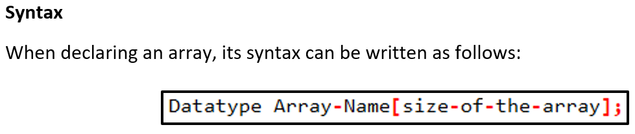
Arrays

Slide 6

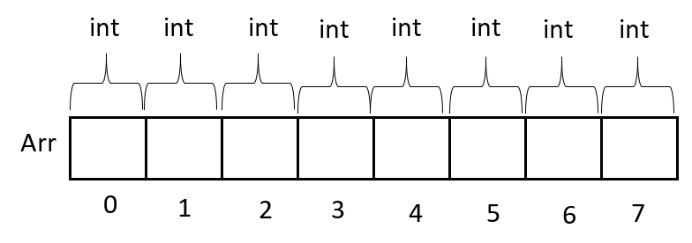
Arrays

Slide 7
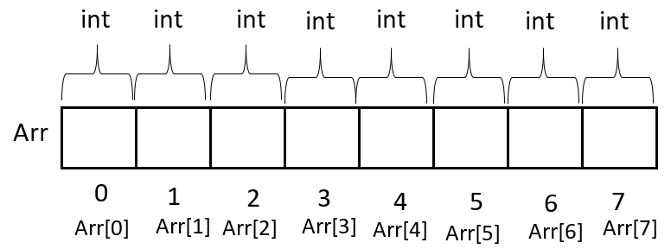
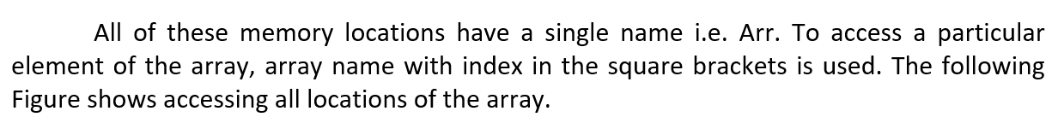
Arrays

Slide 8
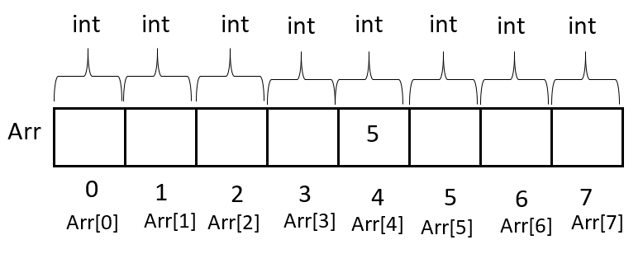
Arrays
For example, if we want to insert 5 at location number 4, the following statement can be written.

Slide 9

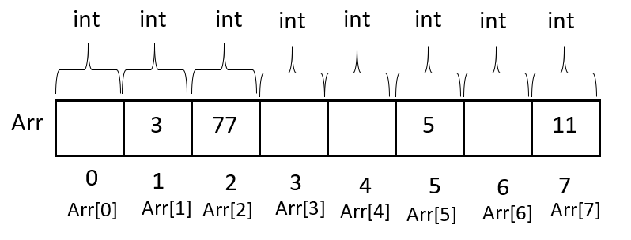
Arrays

Slide 10
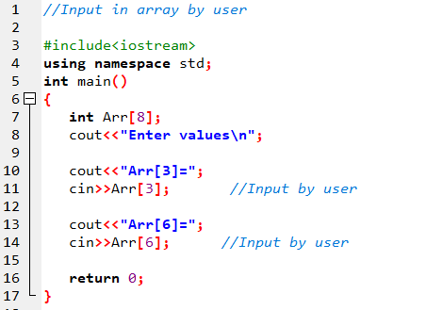

Arrays

Slide 11
Arrays
int
int
int
int
int
int
int
int
Arr
0
1
2
3
4
5
6
7
Arr[0]
Arr[1]
Arr[2]
Arr[3]
Arr[4]
Arr[5]
Arr[6]
Arr[7]

Slide 12
Arrays
int
int
int
int
int
int
int
int
Arr
5
0
1
2
3
4
5
6
7
Arr[0]
Arr[1]
Arr[2]
Arr[3]
Arr[4]
Arr[5]
Arr[6]
Arr[7]

Slide 13
Arrays
int
int
int
int
int
int
int
int
Arr
5
22
0
1
2
3
4
5
6
7
Arr[0]
Arr[1]
Arr[2]
Arr[3]
Arr[4]
Arr[5]
Arr[6]
Arr[7]

Slide 14
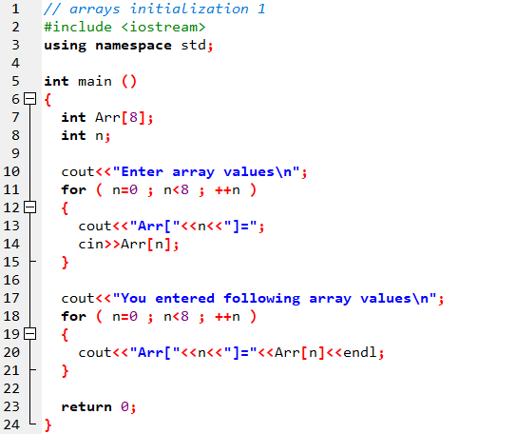
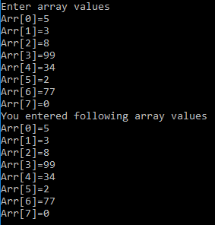
Arrays
int
int
int
int
int
int
int
int
Arr
0
1
2
3
4
5
6
7
Arr[0]
Arr[1]
Arr[2]
Arr[3]
Arr[4]
Arr[5]
Arr[6]
Arr[7]

Slide 15


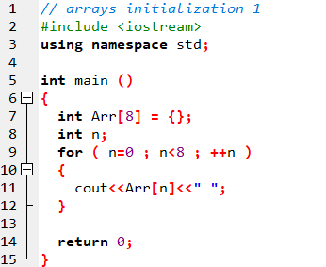
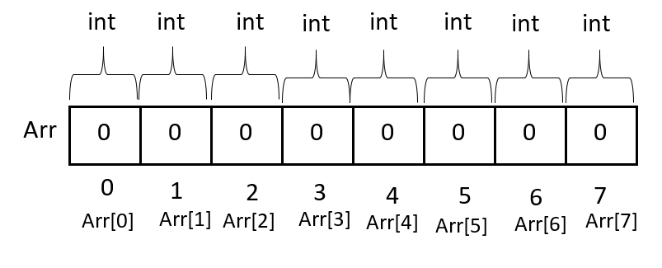
Arrays

Slide 16
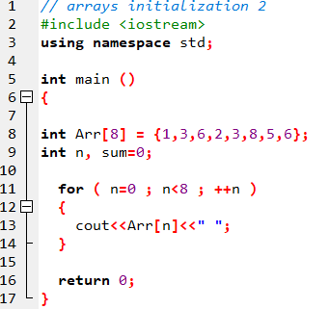
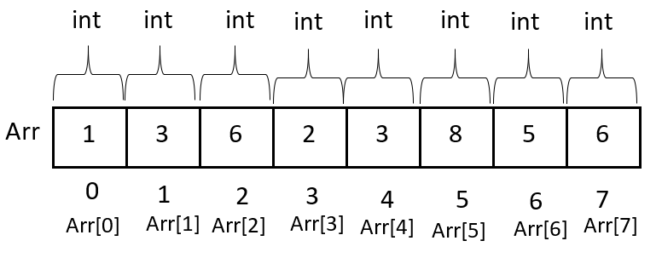
Arrays

Slide 17
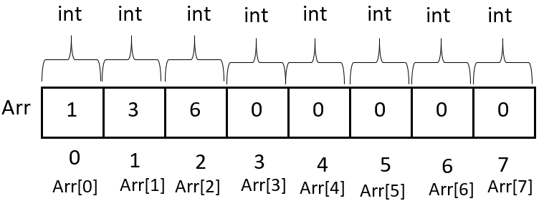
Arrays

Slide 18
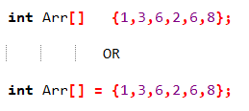
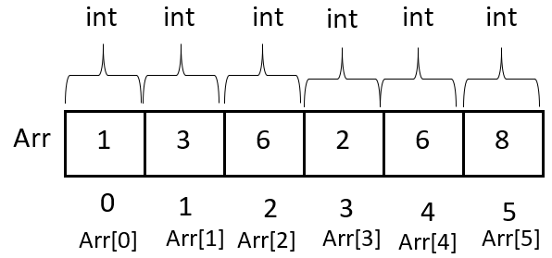
Arrays

Slide 19
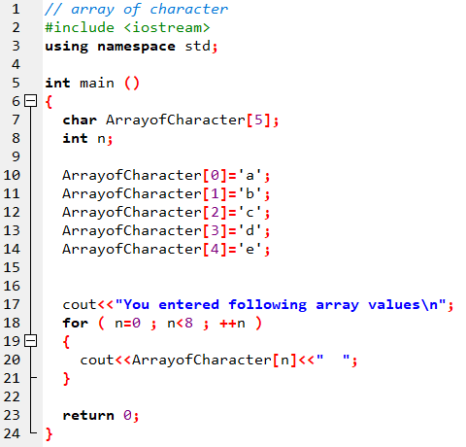

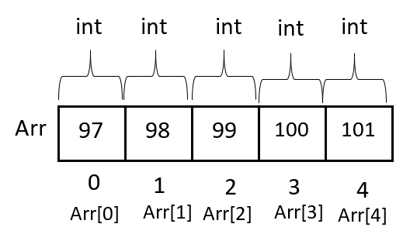

Arrays

Slide 20
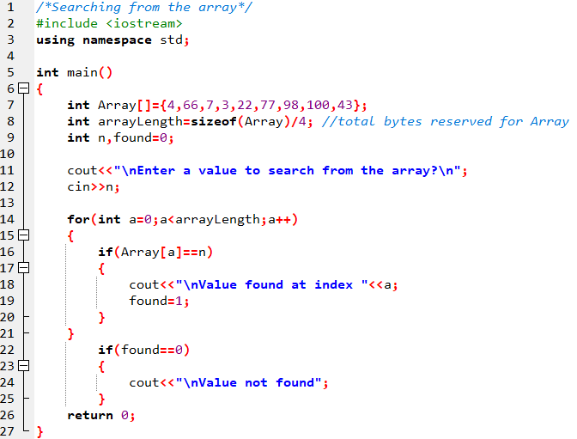


Arrays

Slide 21
Multidimensional Arrays
Multi-dimensional array

Slide 22
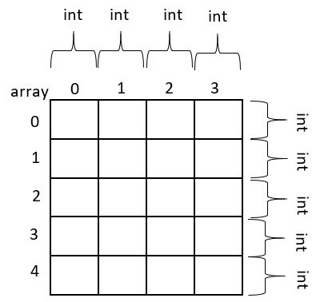
Multidimensional Arrays
2D array

Slide 23
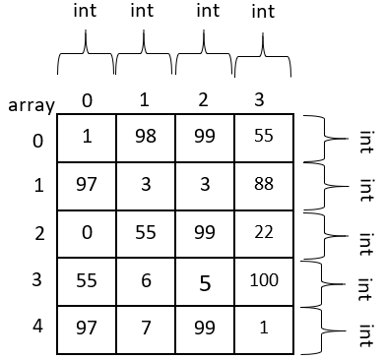
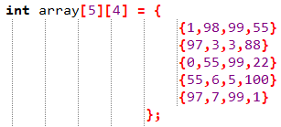
Multidimensional Arrays
2D array: initialization

Slide 24

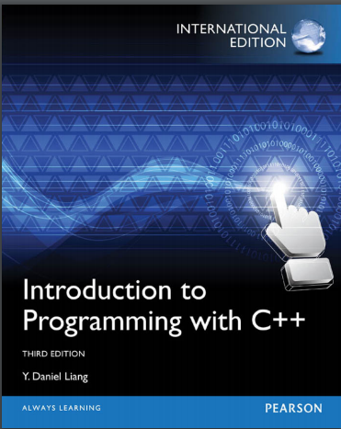
Multidimensional Arrays
2D array: initialization

Slide 25
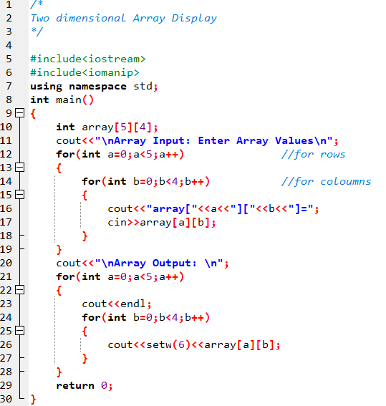
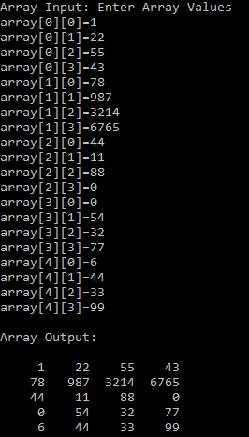
Multidimensional Arrays
2D arrays

Slide 26

Multidimensional Arrays
2D arrays

Slide 27
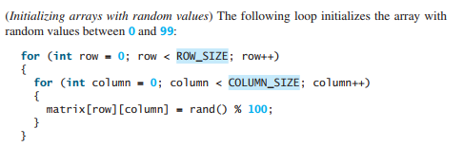
Multidimensional Arrays
2D arrays

Slide 28
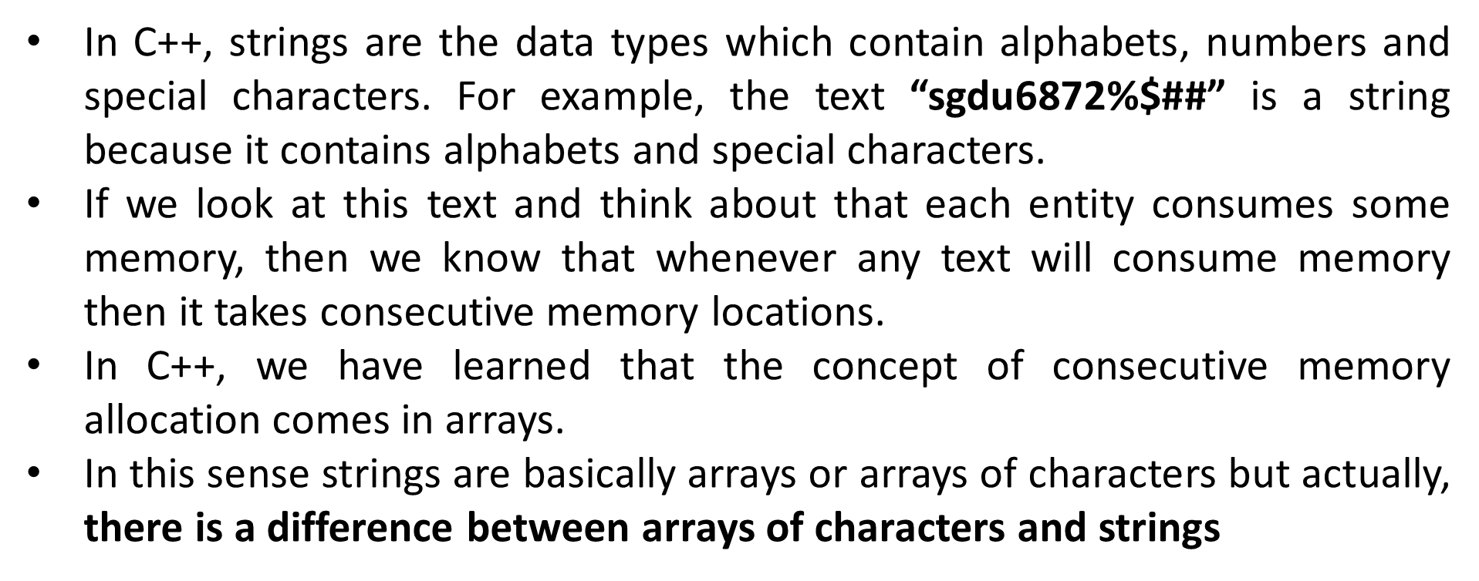
Strings

Slide 29
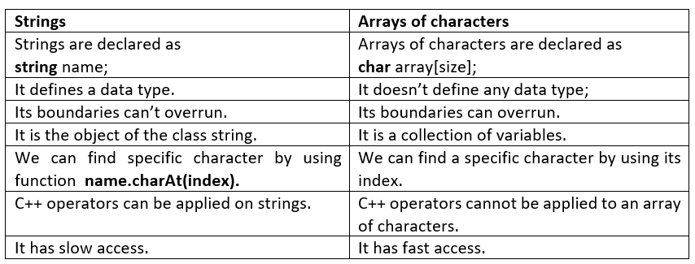
Strings

Slide 30

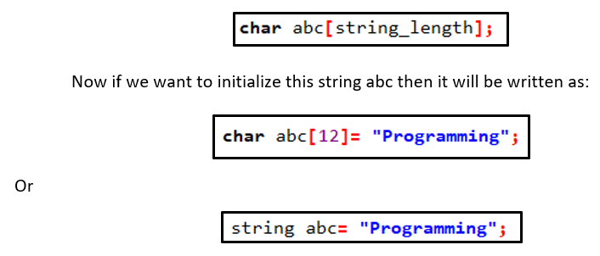
Strings

Slide 31

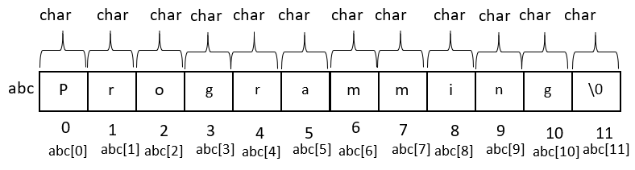
Strings

Slide 32
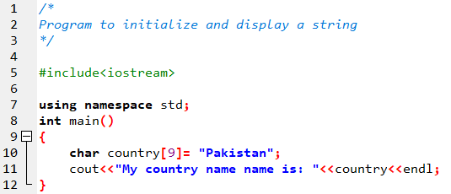
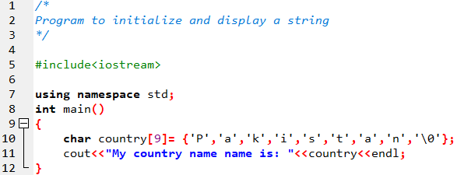
Strings

Slide 33
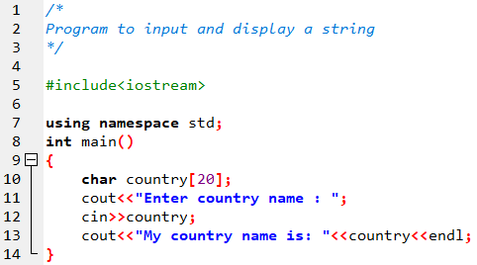


Strings

Slide 34

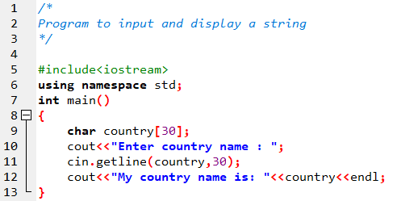
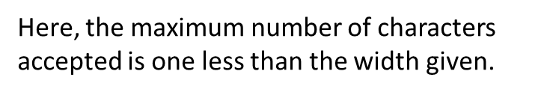
Strings

Slide 35
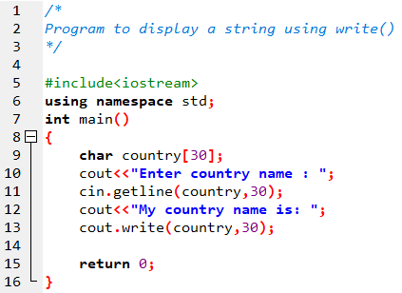
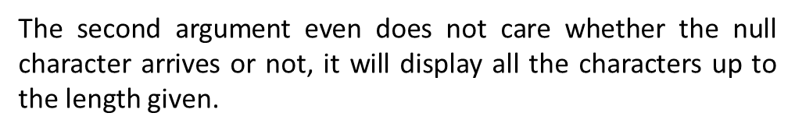

Strings

Slide 36
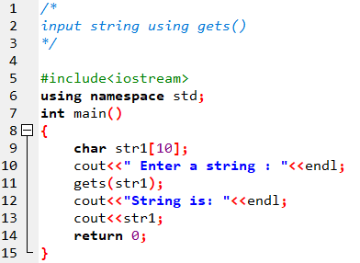
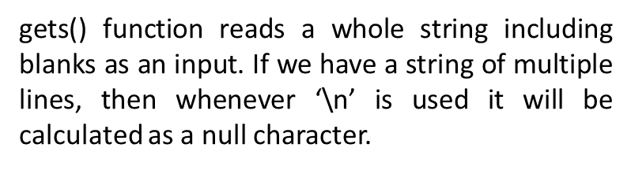
Strings

Slide 37
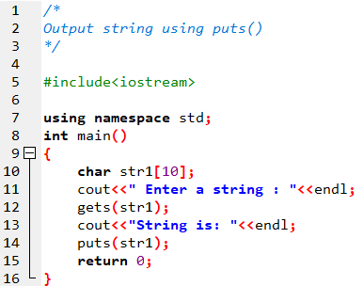
Strings

Slide 38


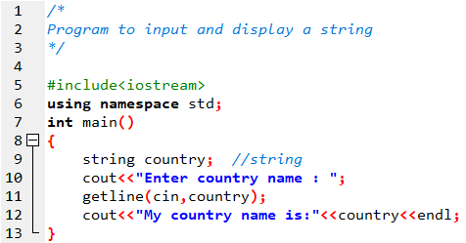
Strings

Slide 39
Todays Lecture
Strings operations
Arrays of string

Slide 40


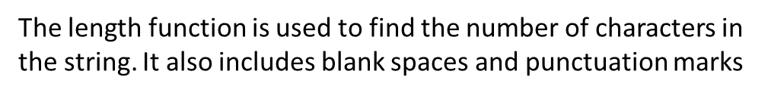
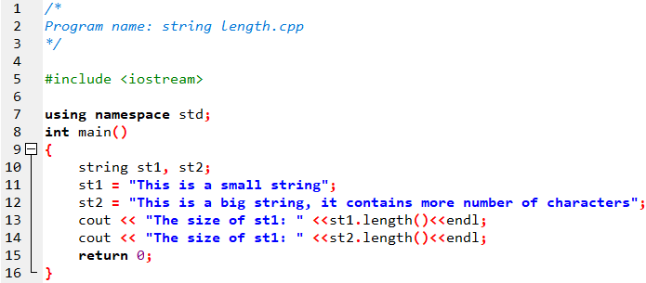

Strings Operations

Slide 41
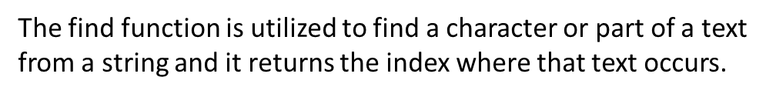
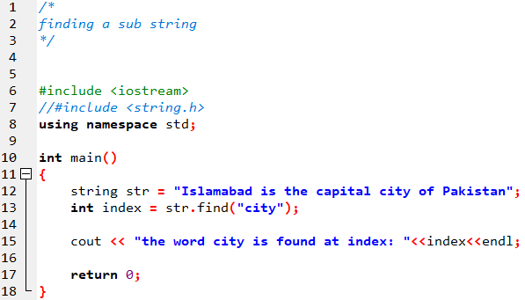
Strings Operations

Slide 42
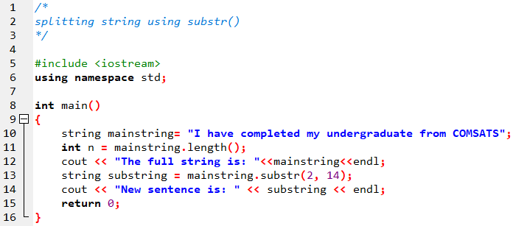
Strings Operations

Slide 43

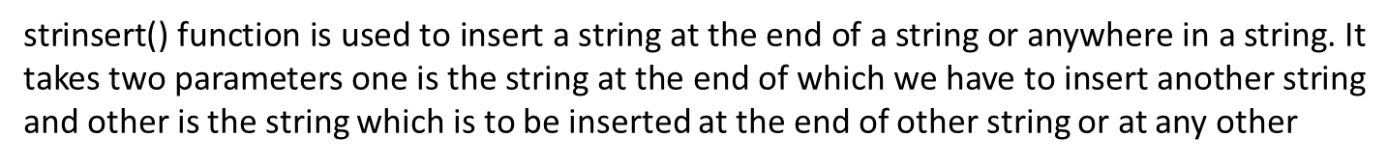
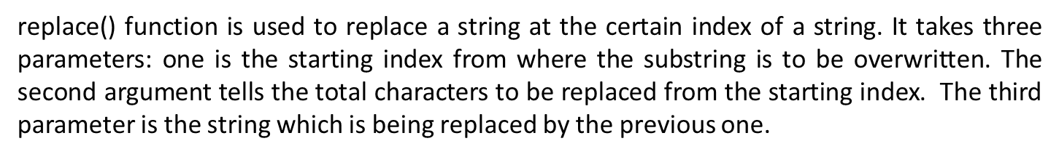
Strings Operations

Slide 44
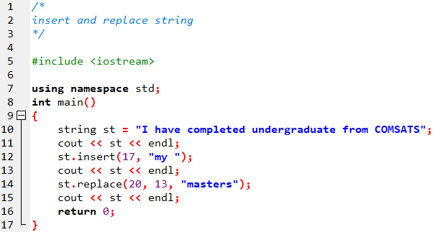

Strings Operations

Slide 45
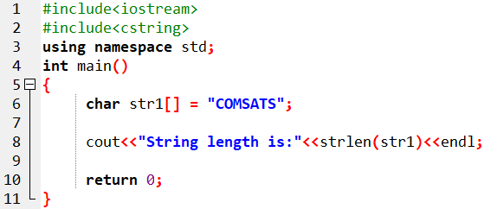

Strings Operations
Functions for C-string
strlen()
Calculates the length of the string
Defined in the cstring header file or string.h #include<cstring>
#include<string.h>

Slide 46



Strings Operations
Functions for C-string
Defined in the cstring header file or string.h #include<cstring>
#include<string.h>

Slide 47



Strings Operations
Functions for C-string
Defined in the cstring header file or string.h #include<cstring>
#include<string.h>

Slide 48

Strings Operations
Functions for C-string
Defined in the cstring header file or string.h #include<cstring>
#include<string.h>
Strsmp(st1,st2)
Compares two string

Slide 49

Strings Operations
Functions for C-string
Defined in the cstring header file or string.h #include<cstring>
#include<string.h>
Strsmp(st1,st2)
Compares two string

Slide 50

Strings Operations
Conversionfunctions
Defined in the cstring header file or string.h #include< cstdlib >
atoi, atof, atol, and itoa are defined in the cstdlib function
atoi can be used to convert a C-string into an integer of the int type
atol can be used to convert a C-string into an integer of the long type atof can be used to convert a C-string into a floating-point number itoa can be used to convert an integer into a C-string

Slide 51

Strings Operations
Conversionfunctions
Defined in the cstring header file or string.h #include< cstdlib >
atoi, atof, atol, and itoa are defined in the cstdlib function
atoi can be used to convert a C-string into an integer of the int type
atol can be used to convert a C-string into an integer of the long type atof can be used to convert a C-string into a floating-point number itoa can be used to convert an integer into a C-string

Slide 52

Strings Operations
Conversionfunctions
Defined in the cstring header file or string.h #include< cstdlib >
atoi, atof, atol, and itoa are defined in the cstdlib function

Slide 53

Strings Operations

Slide 54




Strings Operations

